Slide 1
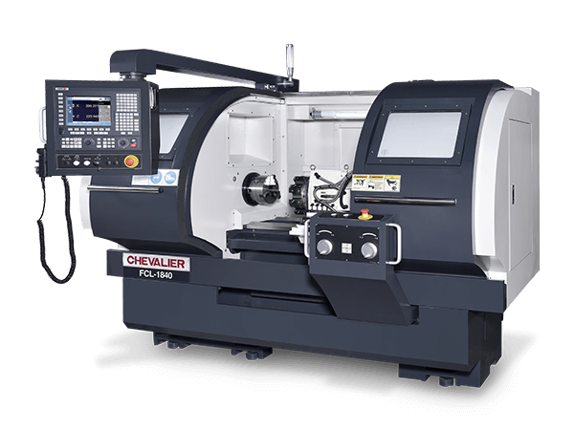
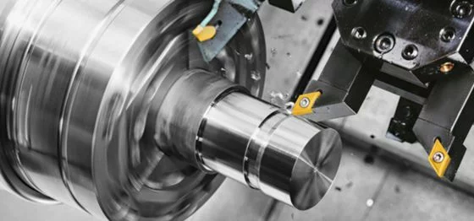
SETTING UP A CNC METAL CUTTING MACHINING FACTORY By- Adarsh Rai
What is CNC Machine?

Slide 2
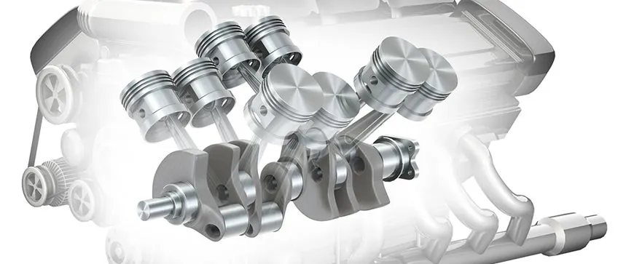
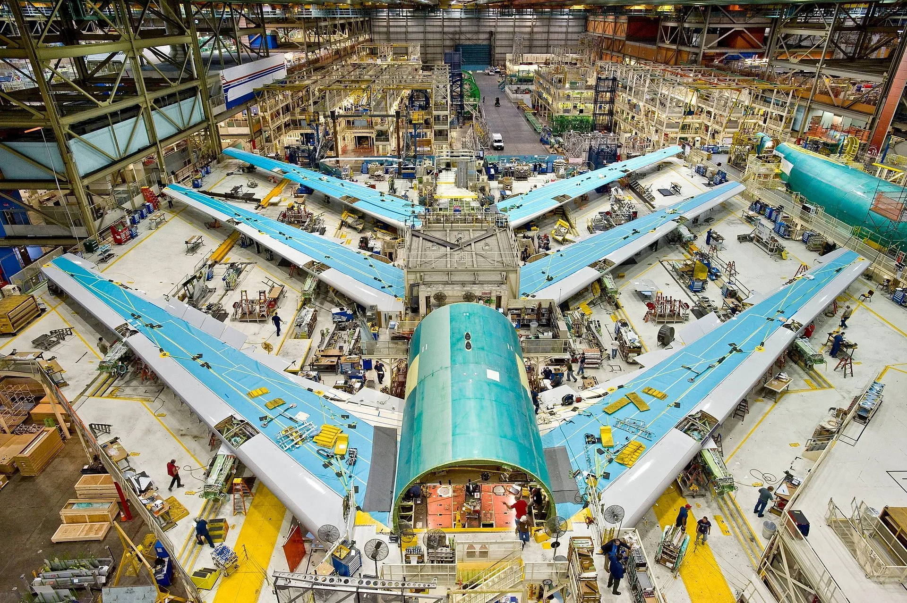

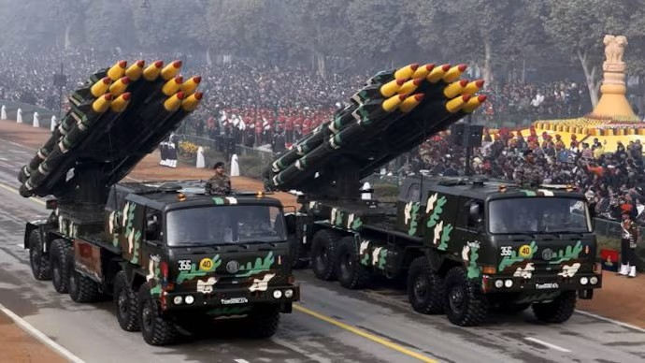
Why & Where are CNC machines used?

Slide 3

Business Analyst Role in setting up a factory
Potential Risks
Conducting Feasibility Studies
Identifying Requirements
Gathering & analyzing data
BUSINESS ANALYST
Equipment Needs
Coordinating with Stakeholders & Development Team
Mapping Workflows
Cost structures

Slide 4
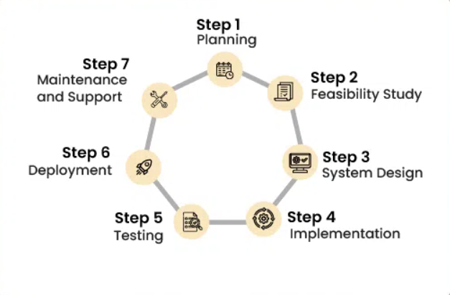
Software Development Life Cycle(SDLC) For Setting Up a CNC Metal Cutting Machining Factory
SDLC cycle provides a structured approach to setting up a CNC metal cutting machining factory, ensuring thorough planning, execution, and ongoing management.

Slide 5
Agile Process Overview
1. Project Vision and Objectives
Define overall vision and objectives.
Conduct initial stakeholder meetings.
Identify high-level requirements.
2.Requirement Gathering
Conduct workshops/interviews.
Document functional/non-functional requirements.,
Prioritize based on impact and feasibility.
Ensure industry compliance.
3.Design and Planning
Develop factory layout and workflow.
Plan utilities (electricity, water, ventilation).
Select/source CNC machines and equipment.
Create phased implementation plan.

Slide 6
4. Implementation (Iterative Cycles)
Execute construction and setup in iterations.
Focus on specific deliverables per iteration.
Regular progress reviews and adjustments.
Continuous stakeholder involvement.
5. Testing and Validation (Continuous)
Perform testing/validation each iteration.
Trial runs of CNC machines.
Test IT systems and software.
Validate workflow and efficiency.
6. Launch and Deployment
Start full-scale production in phases.
Closely monitor initial phase.
Feedback mechanisms for improvement.
Ensure safety/regulatory compliance.
7. Continuous Improvement
Regular maintenance of CNC machines.
Update software/IT systems.
Ongoing training and support for staff.
Periodic audits and performance reviews.

Slide 7
Scrum Framework
Scrum is an agile framework used to manage and complete complex projects by promoting collaboration, flexibility, and continuous improvement.
Key Components of Scrum:
1.Roles
Scrum Master
Development Team
2. Artifacts
Product Backlog
Increment
3. Events
Sprint Planning
Daily Standup
Sprint Review

Slide 8
Development Team Members:
Mechanical Engineers | Maintenance Technicians | IT specialist
Electrical Engineers | Procurement Specialist | Software Engineer
Software Developers | Safety Officer | Network Engineer
Quality Assurance Specialists | Construction manager | Training Manager
Production Managers | Lead Technician

Slide 9
PRODUCT BACKLOG & SPRINT’S

Slide 10


Slide 11


